Slide 1
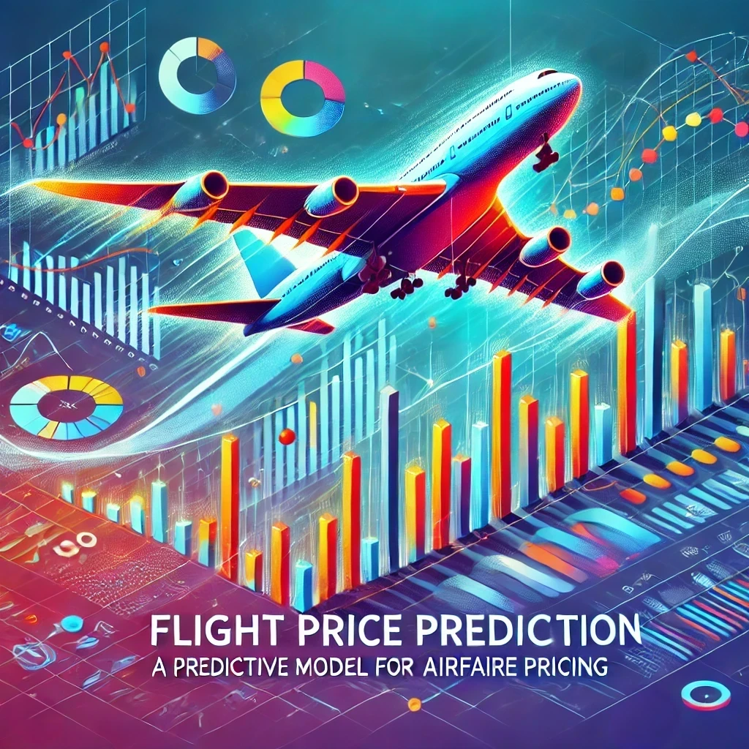

Slide 2
Flight Price Prediction
A Predictive Model for Airfare Pricing
INDIVIDUAL PROJECT BY:
Vatsal Shah
vatsal793@gmail.com

Slide 3
Problem Description
Predicting air ticket prices is a complex challenge in the aviation industry due to the dynamic nature of pricing strategies employed by airlines.
These prices are influenced by various factors, including demand fluctuations, seasonal trends, flight duration, and the specific route taken by the flight.
Accurately forecasting these prices is essential for both airlines and passengers.

Slide 4
Dataset Overview
The dataset includes detailed information about various flights, such as the airline, date of journey, source and destination cities, flight duration, total stops, and ticket price.
The goal is to uncover patterns and trends that influence air ticket pricing.

Slide 5
Approach
1. Data Collection and Preprocessing
2. Exploratory Data Analysis (EDA)
3. Feature Engineering
4. Model Training and Evaluation
5. Hyperparameter Tuning
6. Conclusion and Recommendations

Slide 6
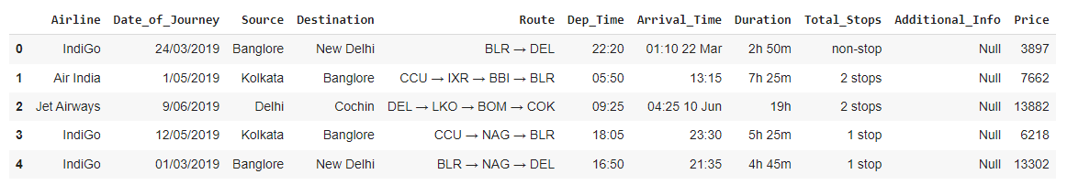
Data Preprocessing
Handling Missing Values: Missing values in the dataset were handled by imputing or dropping based on the feature's importance.
Date Conversion: The journey date was converted into day and month features to capture the time-related trends.
Time Feature Extraction: Departure and arrival times were broken down into hours and minutes for better analysis.
Duration Calculation: Total duration was calculated in minutes for more accurate modeling.

Slide 7
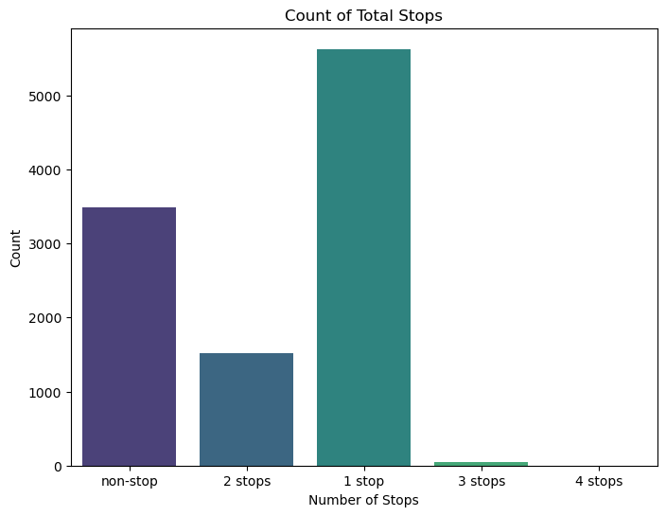
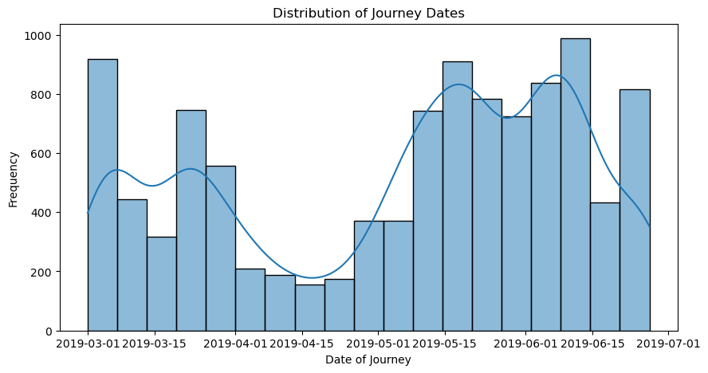
Exploratory Data Analysis
Distributions of Key Features:
Total Stops: A majority of flights have 1 stop, followed by non-stop and 2-stop flights.
Journey Dates: The distribution of journey dates indicates certain peaks, likely due to seasonal trends.

Slide 8
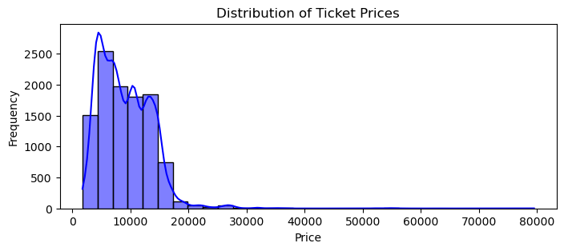
Ticket Prices: Prices are skewed towards the lower end, with a few higher-priced outliers.

Slide 9
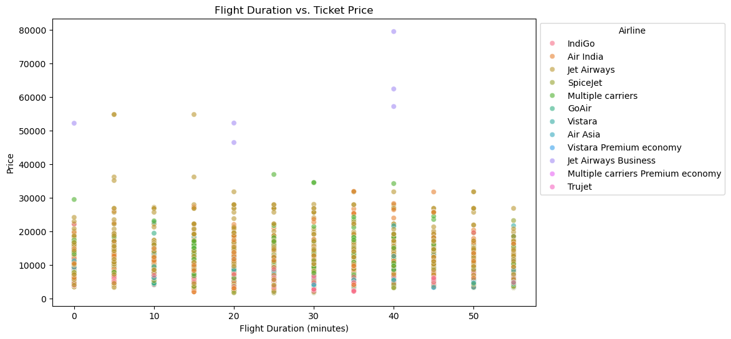
Scatter Plot Analysis
Flight Duration vs. Ticket Price: Highlights the relationship between flight duration and pricing. Longer flights tend to have higher ticket prices.

Slide 10
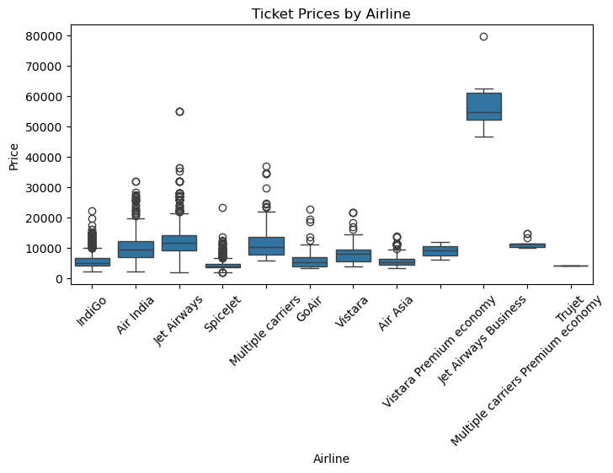
Ticket Prices by Airline: Illustrates how different airlines price their tickets, with some airlines consistently charging higher prices than others.

Slide 11
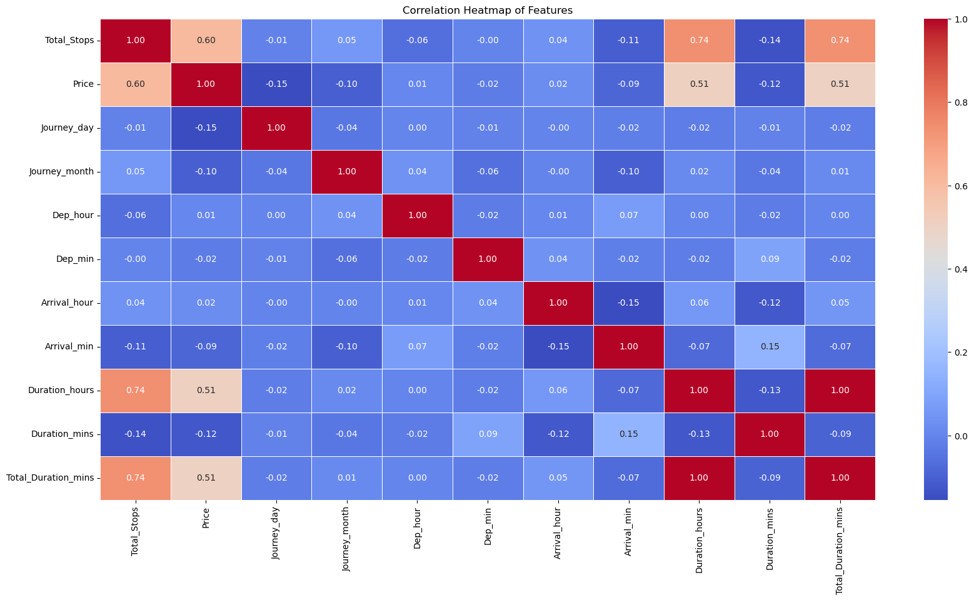
Correlation Heatmap
Strong Positive Correlations:
Total Stops and Price: More stops generally lead to higher ticket prices.
Duration and Price: Longer flight durations are associated with higher prices.

Slide 12
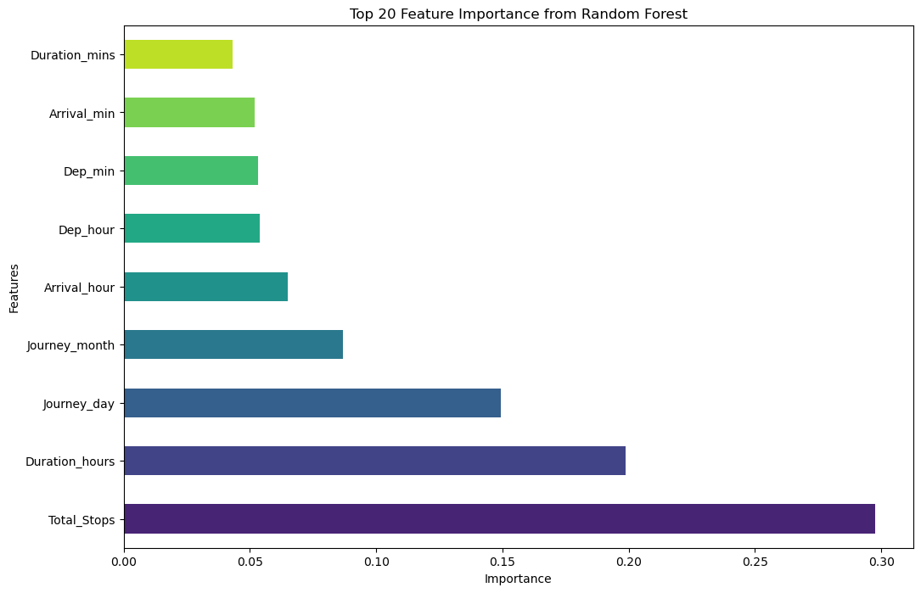
Feature Engineering
Total Stops: The number of stops in a journey.
Flight Duration: Total duration of the flight.
Journey Date: Extracting the day and month from the date of journey.

Slide 13
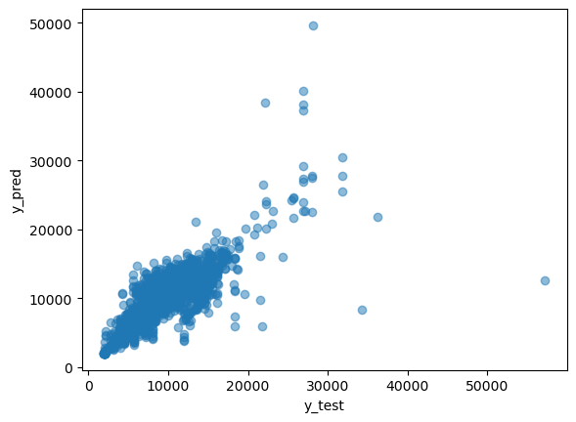
Model Training and Evaluation
Baseline Model:
Model: Random Forest Regressor
Performance: Achieved an R² score of 0.718 on the test set.
Evaluation Metrics:
MAE: 1398.05
RMSE: 2234.97
R²: 0.718

Slide 14
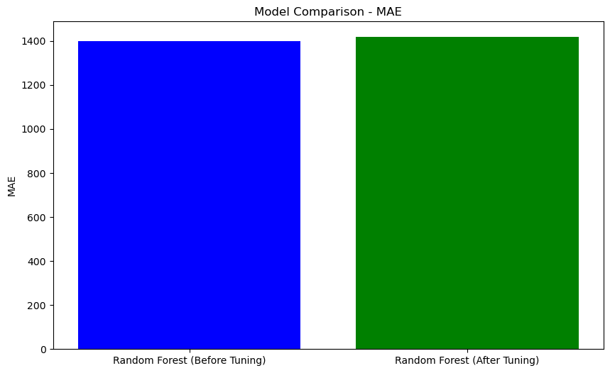
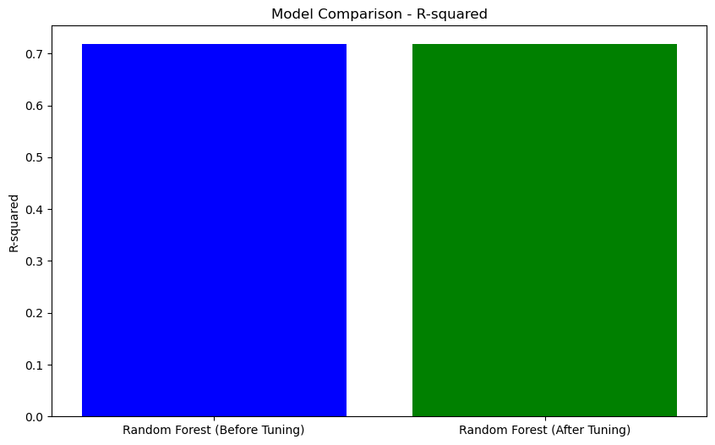
Hyperparameter Tuning
Results:Best Parameters:
n_estimators: 1100,
max_depth: 15,
min_samples_split: 10,
min_samples_leaf: 2,
max_features: 'sqrt'
Performance After Tuning:
MAE: 1417.80
RMSE: 2465.18
R²: 0.718

Slide 15
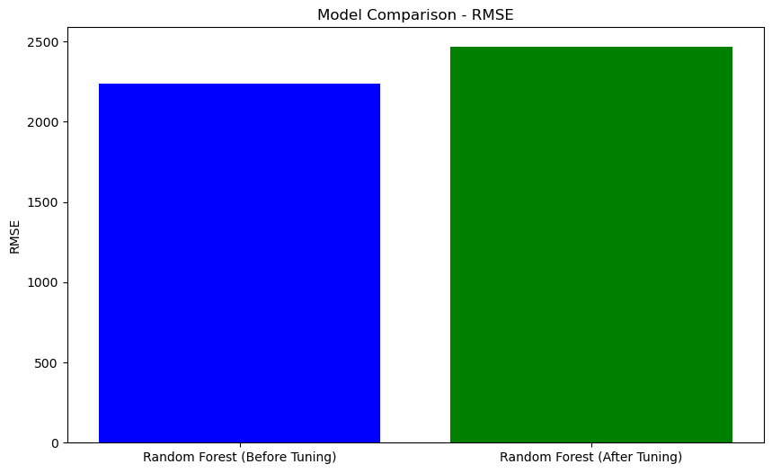
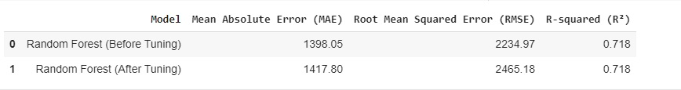

Slide 16
Correlation Heatmap
Total Stops and Price (Strong Positive Correlation ~ 0.60):This indicates that as the number of stops increases, the ticket price also tends to increase. Flights with more stops generally cost more due to longer travel times and increased operational complexity.
Duration (Hours and Minutes) and Price (Moderate Positive Correlation ~ 0.51): There is a moderate positive correlation between flight duration (both in hours and total minutes) and ticket price. Longer flights, which likely cover greater distances or include more layovers, tend to be more expensive.
Total Stops and Duration (Hours and Minutes) (Strong Positive Correlation ~ 0.74): This strong correlation shows that flights with more stops tend to have longer durations. This is expected as additional stops typically add to the overall travel time.
Journey Date/Month and Price (Weak Negative Correlation ~ -0.10 to -0.15): There is a weak negative correlation between the journey date or month and the price, suggesting that certain times of the year may be associated with lower ticket prices, possibly due to low travel seasons or promotional periods.
Departure and Arrival Times (Very Weak to No Correlation): Features like departure hour, minute, and arrival hour have little to no correlation with the ticket price, indicating that the time of day might not significantly impact pricing in the dataset you are analyzing.

Slide 18
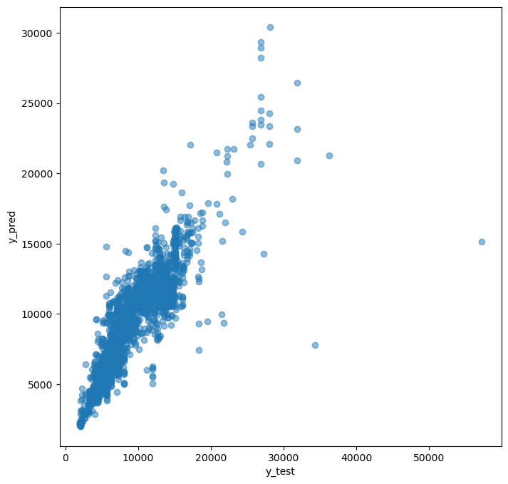
Model Performance
The model performed well on the test data, with an R² score of 0.718. The scatter plot shows the alignment between predicted and actual prices, confirming the model's effectiveness.

Slide 19
Conclusion and Recommendations
Key Findings:
The tuned Random Forest model provided reliable predictions, making it a valuable tool for understanding and anticipating air ticket pricing trends.
The analysis highlighted the importance of factors like Total Stops and Duration, which play a critical role in determining flight prices. This information is crucial for both airlines and consumers.
Recommendations
For Airlines: Dynamic Pricing Strategies: Airlines should leverage models like the Random Forest Regressor to optimize pricing in real-time, ensuring competitive yet profitable ticket pricing.
For Consumers: Informed Booking: Consumers can use insights from such models to determine the best times to purchase tickets, potentially saving money by avoiding peak pricing periods.
By utilizing these predictive insights, stakeholders can make data-driven decisions that enhance both profitability and customer satisfaction in the dynamic aviation market.

Slide 20


